Slide 1





INTELLIGENT SYSTEMS
DONE BY: RAGHAD JABER
23110155
SUBMITTED TO : DR. BATOOL ALARMOUTI

Slide 2
AI Fundamentals
What is intelligence?
Intelligence is made up of:
The ability to learn and understand, to solve problems and to make decisions. and to learn from experience. as well as, adapt to, shape, and select environments.
Neurons: basic units for information processing; they send and receive information.
Synapses: are responsible for communication from one neuron to another using chemicals and electrical signals.
Cerebrum: The largest part of the brain, about 80% of its mass. Plays role in many functions, such as intelligence, memory, reasoning, emotions, and muscle movement.

Slide 3

AI Fundamentals
What is AI?
Artificial intelligence (AI) is a technology that makes computers and machines to simulate human intelligence from learning, comprehension, problem solving, decision making, and creativity.

Slide 4
AI Fundamentals
Types of AI
Artificial Narrow Intelligence (ANI) - its Known as Weak AI as it can mimic thinking but not fully understands it Focuses on one task.
Artificial General Intelligence (AGI) - Its known as Strong AI Machines as they are capable of actual thinking Can learn and perform as a human.
Artificial Superintelligence (ASI) - A theoretical concept where it Surpass human intellectual capabilities.

Slide 5
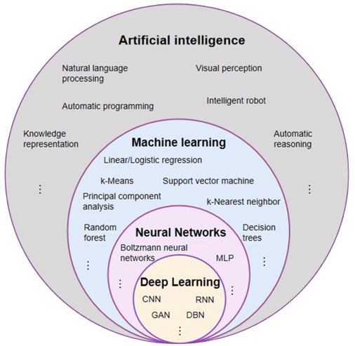
AI Subfields

Slide 6


Machine Learning
What is ML?
Types of ML
Machine learning is a subset of AI. It is focused on teaching computers to learn from data and to improve with experience – instead of being directly coded to do so. Algorithms are trained to find patterns and correlations in data sets to make the best decisions and predictions based on analysis. ML applications improve with use and become more accurate when having more data.
Supervised
Unsupervised
Where we give the model labeled data to learn from it.
For examples , showing the model a dataset with labels of “apples” or “bananas,” it learns to tell them apart
Where we give the model unlabeled data and ask it to find patterns.
For examples , showing the model a dataset without labels of apples or bananas, it will group similar-looking fruits together, even though it doesn't know which is which.

Slide 7

Natural Language Processing (NLP)
What is NLP?
NLP Tasks
is a branch of computer science and AI it uses ML to make computers understand, interpret, and generate human language. By combining computational linguistics with statistical models, machine learning, and deep learning, NLP can process both text and speech.
Named Entity recognition
Part-of-Speech tagging
Key word extraction
Sentiment Analysis

Slide 8
Deep Learning
What is Deep Learning?
a subset of ML that uses multilayered neural networks (deep neural networks) to simulate the complex decision-making power of the human brain.

Slide 9
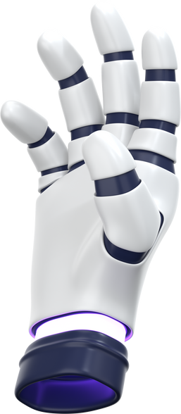


AI Applications
Robotics
AI in robotics enables robots to sense, learn, and react to the environment to perform complex tasks like navigation and object manipulation. It is used in manufacturing, delivery, and sometimes surgical robots to improve efficiency.
Video Games
AI enhances video games by creating intelligent non-player characters (NPCs) that response realistically to players' actions. It also powers tailored gaming experiences for gamers through adaptive difficulty and responses prediction.
Healthcare
AI in healthcare helps with early disease detection, diagnosis, and treatment by analyzing medical data like X-rays, lab results, patient history and data. It also supports virtual health assistants and robotic surgeries, improving patient care and reducing workloads for medical staff.

Slide 10
AI in Healthcare
Diagnostics
analyzing data (images or text) to effectively predict the disease such as heart disease, or cancer.
Robotic Surgery
AI-powered surgical robots help doctors by performing simple and minimal procedures, reducing medical staff efforts.
Remote Patient Monitoring
AI systems monitor health data from patients in real-time such as their heart beat and blood pressure. Alerting doctors and nurses of any critical changes.
Personalized Medicine
AI helps create customized medication based on a patient’s genetics, lifestyle, and reaction of drugs improving treatment outcomes.

Slide 11
Benefits of AI in healthcare – Heart disease diagnosis
Early Detection and Diagnosis
Improved Accuracy
Research and medicine Development
Reduction of Human Error
AI models can analyze vast amounts of patient data to identify early signs of heart disease that might be missed by humans.
ML models can combine multiple risk factors (age, cholesterol, blood pressure) to predict the likelihood of heart disease with high accuracy
AI can help in the discovery of treatments for heart disease by analyzing biological data and predicting medication side effects.
AI reduces the chance of misdiagnosis or delayed diagnosis

Slide 12
Limitations of AI in healthcare – Heart disease diagnosis
Accurate Data and Availability
Ethical and Privacy
Over-reliance on Technology
High Cost and limited Resource
Incomplete, biased, or inconsistent patient data can lead to poor model performance or could lead to incorrect predictions.
Use of sensitive patient data and Misuse or breaches of data
Excessive dependence on AI might lead to ignoring other important signs. And
AI should assist, not replace, human
Developing and maintaining AI models can be expensive and with limited resource

Slide 13

Intelligent Systems security Issues
Why are AI system are Appealing Targets for Cyber Attacks?
they often handle large sensitive data, such as personal and financial. Since they are complicated and data-driven it introduces vulnerabilities that hackers exploit. Additionally, when attackers manage to manipulate an AI model or the data in it they can alter its behavior leading to harmful or misleading outcomes.
Risks:
Data Breaches
When sensitive data is accessed without authorization. Intelligent systems have large data sets making them attractive for hackers
Cloud-based Attacks
Cloud infrastructure are used to host intelligent systems and they are an easy target
Data Poisoning
Attackers insert false or manipulated data into the training dataset.

Slide 14

Intelligent Systems Ethical Issues
Bias
AI systems can reflect biases found in training data, leading to misinformation.
Personal Privacy
Collecting large personal data and improper handling of this data can violate users' privacy.
Job Displacement
It can replace human labor in different industries leading to unemployment and economic inequality.
Manipulation
It can be used to manipulate users through deepfakes, fake news.
Legal Responsibility
Lack of clarity of who to blame if an AI system makes a harmful decision (e.g. misdiagnosis of a disease)

Slide 15

Managing and maintaining an intelligent system
Managing IS
Maintaining IS
overseeing operations, such as collecting data, running processes, and performance.
updating the model, retraining it with new data, fix to keep it accurate and reliable.
To monitor all technical, operational, and ethical aspects for continues operation in an accurate secure way after it has been deployed.
Technical challenges When managing and maintaining IS performance:
Model Drift
The Weakening of the model performance due to changes in data or in the relationships between input and output variables. It negatively impact model performance and in false decision-making and predictions.
Infrastructure Scalability and Latency
As more and more data enters the system the infrastructure will struggle with real-time processing, storage, and model inference.

Slide 16



Security Risks of Intelligent Systems
Users
Organizations
Overdependence
Data Privacy Breaches
Intellectual Property Theft
Compliance of Legal Laws
Relying too heavily can weaken human oversight, increasing system misuse.
IS often require large of personal, sensitive data, if not protected, it can be exposed to unauthorized access.
Competitors hackers may steal proprietary models or datasets leading to harmful innovation.
Using AI without proper data guidance can lead to violations of regulations like GDPR.

Slide 17


Technical & Ethical issues of Intelligent Systems
Ethical
Technical
Lack of Explainability -
Many AI systems do not clearly explain how they reach decisions this leads to trust issues in critical sectors like law or medicine.
Data Dependency IS needs quality datasets. Biased or incomplete data leads inaccurate results.
Vulnerability to Attacks -
Systems can be manipulated through inputs, model theft, or data poisoning.
Bias - If trained on biased data biased discussions will be generated.
Lack of Privacy - IS collect a lot of personal data and sometimes without user consent.
Job Displacement - Automation may replace some jobs leading to unemployment.

Slide 18

Positivity of Intelligent Systems
01
Reduction in Human Error
03
24x7 Availability
Decisions taken by AI are decided by information so errors can be reduced to zero.
Humans need breaks and time off to balance their work and personal lives. But AI can work endlessly without breaks.
02
Enhances decision-making
04
Improves personalization in UX
By leveraging data to identify patterns and trends that could be invisible to humans
by providing personalized recommendations based on preferences and behavior.

Slide 19
References:
What is AI?
AI Drift
AI in Robotics
Model Drift
AI ethical Issues
What is ML?
Adversarial Attack
AI Technical Issues
What is NLP?
Advantages and Disadvantages of AI
What is DL?
What is DL?
Managing & maintaining IS?
AI in healthcare
AI in Video Games

